Slide 1
What is Dynamic Programming
Dynamic programming is a method of solving complex problems by breaking them down into sub-problems that can be solved by working backwards from the last stage.

Slide 2
Steps to Dynamic Programming
Every problem is divided into stages
Each stage requires a decision
Decisions are made to determine the state of the next stage
The solution procedure is to find an optimal solution at each stage for every possible state
This solution procedure often starts at the last stage and works its way forward

Slide 3
5. The (0/1) Knapsack Problem
Given n indivisible objects with positive integer weights W = {w₁,w₂...w_{n}} and positive integer values V = {v₁,v₂...v_{n}} and a knapsack of size (m)
Find the highest valued subset of objects with total weight at most (m)
i = 1
i = 2
i = n
w₁
w_{n}
m
w₂
……..
p₁
p₂
p_{n}

Slide 4
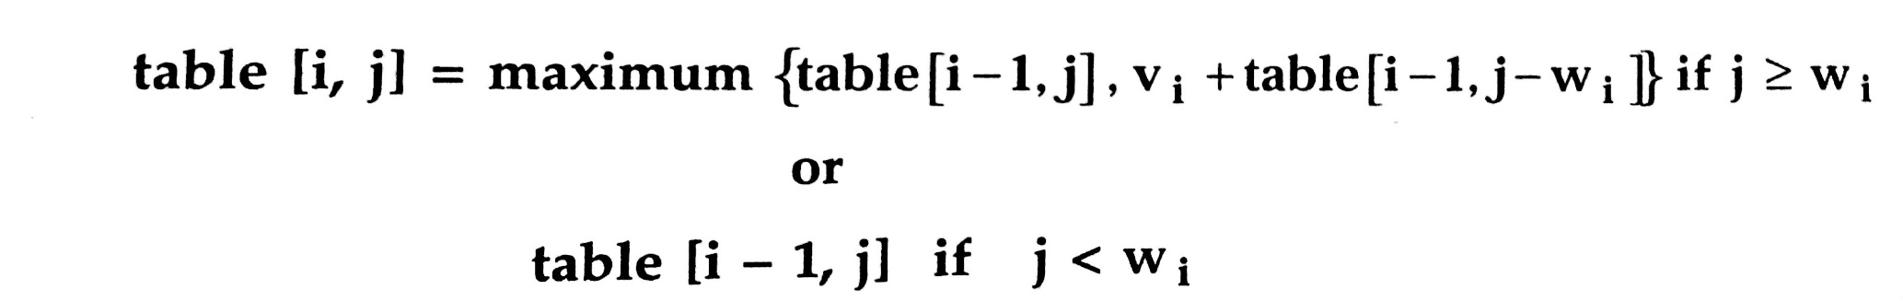
For Solving Knapsack problem using dynamic programming we will create recurrence relation as:
Initially,Table [0,j] = 0 as well as table [i,0] = 0 when j>=0 and i>=0.

Slide 5
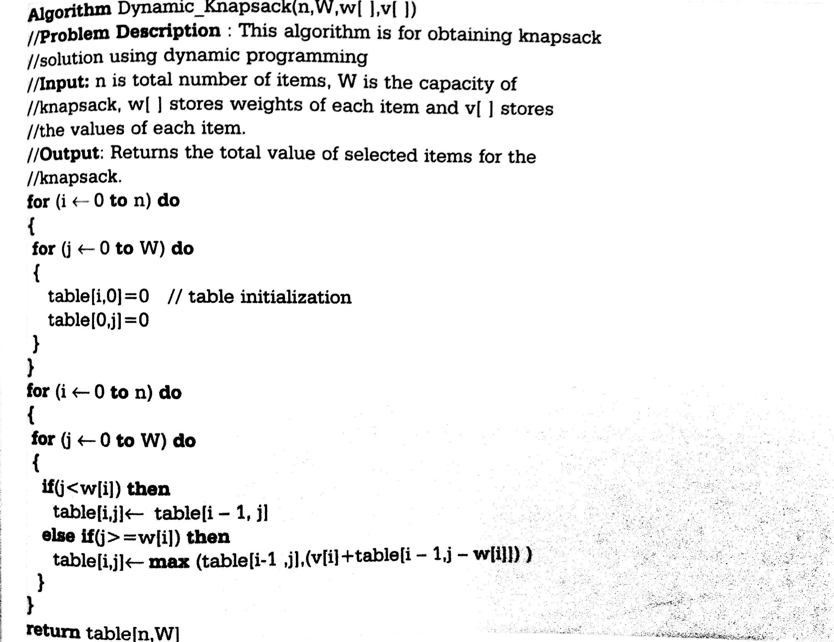
Algorithm

Slide 6
Running time
for w = 0 to W
V[0,w] = 0
for i = 1 to n
V[i,0] = 0
for i = 1 to n
for w = 0 to W
< the rest of the code >
O(W)
Repeat n times
O(W)
What is the running time of this algorithm?
O(n*W)

Slide 7
Example
Let’s run our algorithm on the
following data:
n = 4 (# of elements)
W = 5 (max weight)
Elements (weight, benefit):
(2,3), (3,4), (4,5), (5,6)

Slide 8
Example (2)
i\W
0
1
2
3
4
5
0
0
0
0
0
0
0
1
2
3
4
for w = 0 to W
V[0,w] = 0

Slide 9
Example (3)
i\W
0
1
2
3
4
5
0
0
0
0
0
0
0
1
0
2
0
3
0
4
0
for i = 1 to n
V[i,0] = 0

Slide 10
Example (4)
Items:
1: (2,3)
2: (3,4)
3: (4,5)
4: (5,6)
i\W
0
1
2
3
4
5
i=1
b_{i}=3
w_{i}=2
w=1
w-w_{i} =-1
0
0
0
0
0
0
0
1
0
0
2
0
3
0
4
0
if w_{i} <= w // item i can be part of the solution
if b_{i} + V[i-1,w-w_{i}] > V[i-1,w]
V[i,w] = b_{i} + V[i-1,w- w_{i}]
else
V[i,w] = V[i-1,w]
else V[i,w] = V[i-1,w] // w_{i} > w

Slide 11
Example (5)
Items:
1: (2,3)
2: (3,4)
3: (4,5)
4: (5,6)
i\W
0
1
2
3
4
5
i=1
b_{i}=3
w_{i}=2
w=2
w-w_{i} =0
0
0
0
0
0
0
0
1
0
0
3
2
0
3
0
4
0
if w_{i} <= w // item i can be part of the solution
if b_{i} + V[i-1,w-w_{i}] > V[i-1,w]
V[i,w] = b_{i} + V[i-1,w- w_{i}]
else
V[i,w] = V[i-1,w]
else V[i,w] = V[i-1,w] // w_{i} > w

Slide 12
Example (6)
Items:
1: (2,3)
2: (3,4)
3: (4,5)
4: (5,6)
i\W
0
1
2
3
4
5
i=1
b_{i}=3
w_{i}=2
w=3
w-w_{i} =1
0
0
0
0
0
0
0
1
0
0
3
3
2
0
3
0
4
0
if w_{i} <= w // item i can be part of the solution
if b_{i} + V[i-1,w-w_{i}] > V[i-1,w]
V[i,w] = b_{i} + V[i-1,w- w_{i}]
else
V[i,w] = V[i-1,w]
else V[i,w] = V[i-1,w] // w_{i} > w

Slide 13
Example (7)
Items:
1: (2,3)
2: (3,4)
3: (4,5)
4: (5,6)
i\W
0
1
2
3
4
5
i=1
b_{i}=3
w_{i}=2
w=4
w-w_{i} =2
0
0
0
0
0
0
0
1
0
0
3
3
3
2
0
3
0
4
0
if w_{i} <= w // item i can be part of the solution
if b_{i} + V[i-1,w-w_{i}] > V[i-1,w]
V[i,w] = b_{i} + V[i-1,w- w_{i}]
else
V[i,w] = V[i-1,w]
else V[i,w] = V[i-1,w] // w_{i} > w

Slide 14
Example (8)
Items:
1: (2,3)
2: (3,4)
3: (4,5)
4: (5,6)
i\W
0
1
2
3
4
5
i=1
b_{i}=3
w_{i}=2
w=5
w-w_{i} =3
0
0
0
0
0
0
0
1
0
0
3
3
3
3
2
0
3
0
4
0
if w_{i} <= w // item i can be part of the solution
if b_{i} + V[i-1,w-w_{i}] > V[i-1,w]
V[i,w] = b_{i} + V[i-1,w- w_{i}]
else
V[i,w] = V[i-1,w]
else V[i,w] = V[i-1,w] // w_{i} > w

Slide 15
Example (9)
Items:
1: (2,3)
2: (3,4)
3: (4,5)
4: (5,6)
i\W
0
1
2
3
4
5
i=2
b_{i}=4
w_{i}=3
w=1
w-w_{i} =-2
0
0
0
0
0
0
0
1
0
0
3
3
3
3
2
0
0
3
0
4
0
if w_{i} <= w // item i can be part of the solution
if b_{i} + V[i-1,w-w_{i}] > V[i-1,w]
V[i,w] = b_{i} + V[i-1,w- w_{i}]
else
V[i,w] = V[i-1,w]
else V[i,w] = V[i-1,w] // w_{i} > w

Slide 16
Example (10)
Items:
1: (2,3)
2: (3,4)
3: (4,5)
4: (5,6)
i\W
0
1
2
3
4
5
i=2
b_{i}=4
w_{i}=3
w=2
w-w_{i} =-1
0
0
0
0
0
0
0
1
0
0
3
3
3
3
2
0
0
3
3
0
4
0
if w_{i} <= w // item i can be part of the solution
if b_{i} + V[i-1,w-w_{i}] > V[i-1,w]
V[i,w] = b_{i} + V[i-1,w- w_{i}]
else
V[i,w] = V[i-1,w]
else V[i,w] = V[i-1,w] // w_{i} > w

Slide 17
Example (11)
Items:
1: (2,3)
2: (3,4)
3: (4,5)
4: (5,6)
i\W
0
1
2
3
4
5
i=2
b_{i}=4
w_{i}=3
w=3
w-w_{i} =0
0
0
0
0
0
0
0
1
0
0
3
3
3
3
2
0
0
3
4
3
0
4
0
if w_{i} <= w // item i can be part of the solution
if b_{i} + V[i-1,w-w_{i}] > V[i-1,w]
V[i,w] = b_{i} + V[i-1,w- w_{i}]
else
V[i,w] = V[i-1,w]
else V[i,w] = V[i-1,w] // w_{i} > w

Slide 18
Example (12)
Items:
1: (2,3)
2: (3,4)
3: (4,5)
4: (5,6)
i\W
0
1
2
3
4
5
i=2
b_{i}=4
w_{i}=3
w=4
w-w_{i} =1
0
0
0
0
0
0
0
1
0
0
3
3
3
3
2
0
0
3
4
4
3
0
4
0
if w_{i} <= w // item i can be part of the solution
if b_{i} + V[i-1,w-w_{i}] > V[i-1,w]
V[i,w] = b_{i} + V[i-1,w- w_{i}]
else
V[i,w] = V[i-1,w]
else V[i,w] = V[i-1,w] // w_{i} > w

Slide 19
Example (13)
Items:
1: (2,3)
2: (3,4)
3: (4,5)
4: (5,6)
i\W
0
1
2
3
4
5
i=2
b_{i}=4
w_{i}=3
w=5
w-w_{i} =2
0
0
0
0
0
0
0
1
0
0
3
3
3
3
2
0
0
3
4
4
7
3
0
4
0
if w_{i} <= w // item i can be part of the solution
if b_{i} + V[i-1,w-w_{i}] > V[i-1,w]
V[i,w] = b_{i} + V[i-1,w- w_{i}]
else
V[i,w] = V[i-1,w]
else V[i,w] = V[i-1,w] // w_{i} > w

Slide 20
Example (14)
Items:
1: (2,3)
2: (3,4)
3: (4,5)
4: (5,6)
i\W
0
1
2
3
4
5
i=3
b_{i}=5
w_{i}=4
w= 1..3
0
0
0
0
0
0
0
1
0
0
3
3
3
3
2
0
0
3
4
4
7
3
0
0
3
4
4
0
if w_{i} <= w // item i can be part of the solution
if b_{i} + V[i-1,w-w_{i}] > V[i-1,w]
V[i,w] = b_{i} + V[i-1,w- w_{i}]
else
V[i,w] = V[i-1,w]
else V[i,w] = V[i-1,w] // w_{i} > w

Slide 21
Example (15)
Items:
1: (2,3)
2: (3,4)
3: (4,5)
4: (5,6)
i\W
0
1
2
3
4
5
i=3
b_{i}=5
w_{i}=4
w= 4
w- w_{i}=0
0
0
0
0
0
0
0
1
0
0
3
3
3
3
2
0
0
3
4
4
7
3
0
0
3
4
5
4
0
if w_{i} <= w // item i can be part of the solution
if b_{i} + V[i-1,w-w_{i}] > V[i-1,w]
V[i,w] = b_{i} + V[i-1,w- w_{i}]
else
V[i,w] = V[i-1,w]
else V[i,w] = V[i-1,w] // w_{i} > w

Slide 22
Example (16)
Items:
1: (2,3)
2: (3,4)
3: (4,5)
4: (5,6)
i\W
0
1
2
3
4
5
i=3
b_{i}=5
w_{i}=4
w= 5
w- w_{i}=1
0
0
0
0
0
0
0
1
0
0
3
3
3
3
2
0
0
3
4
4
7
3
0
0
3
4
5
7
4
0
if w_{i} <= w // item i can be part of the solution
if b_{i} + V[i-1,w-w_{i}] > V[i-1,w]
V[i,w] = b_{i} + V[i-1,w- w_{i}]
else
V[i,w] = V[i-1,w]
else V[i,w] = V[i-1,w] // w_{i} > w

Slide 23
Example (17)
Items:
1: (2,3)
2: (3,4)
3: (4,5)
4: (5,6)
i\W
0
1
2
3
4
5
i=4
b_{i}=6
w_{i}=5
w= 1..4
0
0
0
0
0
0
0
1
0
0
3
3
3
3
2
0
0
3
4
4
7
3
0
0
3
4
5
7
4
0
0
3
4
5
if w_{i} <= w // item i can be part of the solution
if b_{i} + V[i-1,w-w_{i}] > V[i-1,w]
V[i,w] = b_{i} + V[i-1,w- w_{i}]
else
V[i,w] = V[i-1,w]
else V[i,w] = V[i-1,w] // w_{i} > w

Slide 24
Example (18)
Items:
1: (2,3)
2: (3,4)
3: (4,5)
4: (5,6)
i\W
0
1
2
3
4
5
i=4
b_{i}=6
w_{i}=5
w= 5
w- w_{i}=0
0
0
0
0
0
0
0
1
0
0
3
3
3
3
2
0
0
3
4
4
7
3
0
0
3
4
5
7
4
0
0
3
4
5
7
if w_{i} <= w // item i can be part of the solution
if b_{i} + V[i-1,w-w_{i}] > V[i-1,w]
V[i,w] = b_{i} + V[i-1,w- w_{i}]
else
V[i,w] = V[i-1,w]
else V[i,w] = V[i-1,w] // w_{i} > w

Slide 25
How to find actual Knapsack Items
All of the information we need is in the table.
V[n,W] is the maximal value of items that can be placed in the Knapsack.
Let i=n and k=W
if V[i,k] ≠ V[i−1,k] then
mark the i^{th} item as in the knapsack
i = i−1, k = k-w_{i}
else
i = i−1 // Assume the i^{th} item is not in the knapsack
// Could it be in the optimally packed knapsack?

Slide 26
Finding the Items
Items:
1: (2,3)
2: (3,4)
3: (4,5)
4: (5,6)
i\W
0
1
2
3
4
5
i=4
k= 5
b_{i}=6
w_{i}=5
V[i,k] = 7
V[i−1,k] =7
0
0
0
0
0
0
0
1
0
0
3
3
3
3
2
0
0
3
4
4
7
3
0
0
3
4
5
7
4
0
0
3
4
5
7
i=n, k=W
while i,k > 0
if V[i,k] ≠ V[i−1,k] then
mark the i^{th} item as in the knapsack
i = i−1, k = k-w_{i}
else
i = i−1

Slide 27
Finding the Items (2)
Items:
1: (2,3)
2: (3,4)
3: (4,5)
4: (5,6)
i\W
0
1
2
3
4
5
i=4
k= 5
b_{i}=6
w_{i}=5
V[i,k] = 7
V[i−1,k] =7
0
0
0
0
0
0
0
1
0
0
3
3
3
3
2
0
0
3
4
4
7
3
0
0
3
4
5
7
4
0
0
3
4
5
7
i=n, k=W
while i,k > 0
if V[i,k] ≠ V[i−1,k] then
mark the i^{th} item as in the knapsack
i = i−1, k = k-w_{i}
else
i = i−1

Slide 28
Finding the Items (3)
Items:
1: (2,3)
2: (3,4)
3: (4,5)
4: (5,6)
i\W
0
1
2
3
4
5
i=3
k= 5
b_{i}=5
w_{i}=4
V[i,k] = 7
V[i−1,k] =7
0
0
0
0
0
0
0
1
0
0
3
3
3
3
2
0
0
3
4
4
7
3
0
0
3
4
5
7
4
0
0
3
4
5
7
i=n, k=W
while i,k > 0
if V[i,k] ≠ V[i−1,k] then
mark the i^{th} item as in the knapsack
i = i−1, k = k-w_{i}
else
i = i−1

Slide 29
Finding the Items (4)
Items:
1: (2,3)
2: (3,4)
3: (4,5)
4: (5,6)
i\W
0
1
2
3
4
5
i=2
k= 5
b_{i}=4
w_{i}=3
V[i,k] = 7
V[i−1,k] =3
k − w_{i}=2
0
0
0
0
0
0
0
1
0
0
3
3
3
3
2
0
0
3
4
4
7
7
3
0
0
3
4
5
7
4
0
0
3
4
5
7
i=n, k=W
while i,k > 0
if V[i,k] ≠ V[i−1,k] then
mark the i^{th} item as in the knapsack
i = i−1, k = k-w_{i}
else
i = i−1

Slide 30
Finding the Items (5)
Items:
1: (2,3)
2: (3,4)
3: (4,5)
4: (5,6)
i\W
0
1
2
3
4
5
i=1
k= 2
b_{i}=3
w_{i}=2
V[i,k] = 3
V[i−1,k] =0
k − w_{i}=0
0
0
0
0
0
0
0
1
0
0
3
3
3
3
3
2
0
0
3
4
4
7
3
0
0
3
4
5
7
4
0
0
3
4
5
7
i=n, k=W
while i,k > 0
if V[i,k] ≠ V[i−1,k] then
mark the i^{th} item as in the knapsack
i = i−1, k = k-w_{i}
else
i = i−1

Slide 31
Finding the Items (6)
Items:
1: (2,3)
2: (3,4)
3: (4,5)
4: (5,6)
i\W
0
1
2
3
4
5
i=0
k= 0
0
0
0
0
0
0
0
1
0
0
3
3
3
3
2
0
0
3
4
4
7
3
0
0
3
4
5
7
The optimal knapsack should contain {1, 2}
4
0
0
3
4
5
7
i=n, k=W
while i,k > 0
if V[i,k] ≠ V[i−1,k] then
mark the n^{th} item as in the knapsack
i = i−1, k = k-w_{i}
else
i = i−1

Slide 32
Finding the Items (7)
Items:
1: (2,3)
2: (3,4)
3: (4,5)
4: (5,6)
i\W
0
1
2
3
4
5
0
0
0
0
0
0
0
1
0
0
3
3
3
3
3
2
0
0
3
4
4
7
7
3
0
0
3
4
5
7
The optimal knapsack should contain {1, 2}
4
0
0
3
4
5
7
i=n, k=W
while i,k > 0
if V[i,k] ≠ V[i−1,k] then
mark the n^{th} item as in the knapsack
i = i−1, k = k-w_{i}
else
i = i−1

Slide 33
Thank you

